Slide 1
What is Agile?
Agile is a set of Values and Principles

Slide 2
What are four values of Agile?
Individuals and interactions over processes and tools
Working software over comprehensive documentation
Customer collaboration over contract negotiation
Responding to change over following a plan

Slide 3
What are twelve principles of Agile?
Our highest priority is to satisfy the customer through early and continuous delivery of valuable software.
Working software is the primary measure of progress.
Welcome changing requirements, even late in development. Agile processes harness change for the customer's competitive advantage.
Agile processes promote sustainable development. The sponsors, developers, and users should be able to maintain a constant pace indefinitely.
Deliver working software frequently, from a couple of weeks to a couple of months, with a preference to the shorter timescale.
Continuous attention to technical excellence and good design enhances agility.
Business people and developers must work together daily throughout the project.
Simplicity--the art of maximizing the amount of work not done--is essential.
Build projects around motivated individuals. Give them the environment and support they need, and trust them to get the job done.
The best architectures, requirements, and designs emerge from self-organizing teams.
The most efficient and effective method of conveying information to and within a development team is face-to-face conversation.
At regular intervals, the team reflects on how to become more effective, then tunes and adjusts its behavior accordingly.

Slide 4
Why do we need Agile?
The change is welcomed. For example after the sprint demo if client does not like something, we can take their feedback and improve the product. Requirement change is OK.
Since it is iterative development process, the development team can develop piece of functionality, get feedback and improve next iteration. So the product will be continuously improved.
Waste is eliminated in agile with the help of scrum master. For example if I am blocked, I don’t have to wait and waste my time. Since team members communicates with each other efficiently we can be more productive by preventing duplicated effort.

Slide 5
Why do we need Agile?
Early Delivery
Adapts with changes
Better Customer Experience
Scope Control
Lower Risk Control
Collaboration and Communication

Slide 6
Agile is Mindset
Described by 4 values
Defined by 12 principles
Implemented by different frameworks

Slide 7
What is difference between Agile and Scrum?
Agile is set of methods and practices based on values and principles expressed in the Agile Manifesto, which includes things like collaboration, self organized, and across functionality of teams
Scrum is framework that implements agile principles that can be used to manage iterative and incremental projects of all types.
Agile is Philosophy and scrum is framework that implements that philosophy.

Slide 8
What is Waterfall?
Sequential Design Process
Advantages:
In Big Project documentation is important
Clear goal and Directions
Progress can be easily measured
Disadvantages:
Time Consuming
Customer Dissatisfaction
Risk Factor

Slide 9
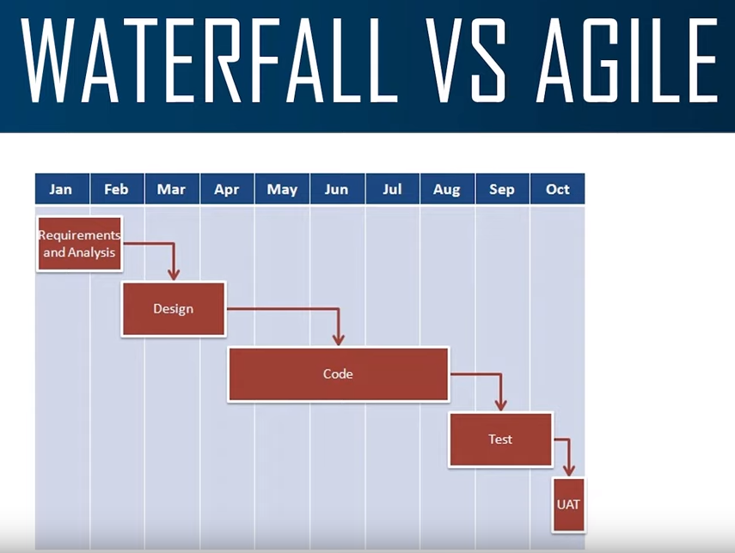

Slide 10
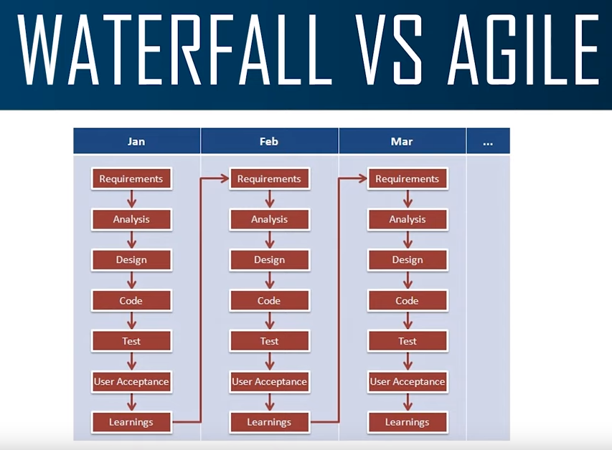

Slide 11
How can you get the log of the reports? – Jenkins
How do you integrate Jenkins with Framework?
How would you use test data in your framework?
Three things your friends would tell about you
2 things you are strong at?
2 things you are weak at?
What motivates you to go to work everyday?
What demotivates you to go to work?
What do you feel about manual testing?
Who accepts user stories after testing?

Slide 12
How many people worked on that project?
What actually Selenium does in your framework?
What was the biggest project you worked in?
Tell me about yourself and your project?
Tell me about your daily activities and framework?
1. 8:30-9
2. CHECK EMAIL
3. GET COFFEE
4. CHECK SMOKE TEST RESULT
5. IF THERE IS ANY FAILURE I ANYLZE IT IF THERE ANY ISSUE I REPORT IT
6. I CONTINUE
7. 9:45 STAND UP MEETING
8.
What is your regression execution schedule? Every day? Every week? Every month
How do you do maintain your Selenium scripts?
How many test cases do you need to update if there is a change?
Do you know swager?
Have you used Postman?

